Slide 1
BUS101 AccountIng - INTRO
Oct. 4-6 2017

Slide 2
It is announced!
Check times on lms.

Slide 3
Today’s Agenda
1)Two Important Cost Types:
Fixed Costs
Variable Costs
2)Fixed Cost Types:
Direct Fixed Cost
Indirect Fixed Cost
3)Initial Investment
3)Contribution Margin
4)Break-Even Point

Slide 4

We should decide the cost type…
Is it variable?
Is it fixed?

Slide 5
Fixed Cost vs. Variable Cost
Fixed Cost: Business expenses that are not dependent on the level of goods or services produced by the business for a given period. (Rent, utilities etc.)
Variable Cost: Costs that change in proportion to the good or service that a business produces. (Raw materials etc.)

Slide 6
Total Fixed Cost & Fixed Cost Types
Total Fixed Cost = Direct Fixed Cost + Indirect Fixed Cost
Direct Fixed Cost: Rent, maintenance or utility costs for facilities or equipment
Indirect Fixed Cost: Administration, Marketing, Selling and Distribution, R&D etc.

Slide 7
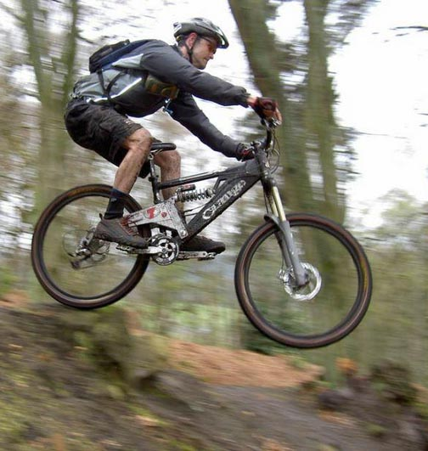

Slide 8
To make and sell mountain bike we need…
Metal materials like steel and aluminum for the frame
Accessories like reflectors and handlebar grips
To pay the laborers who put the bikes together
To pay the heating bill
To pay the office receptionist
To pay rent for the office building and factory
To pay advertising and marketing expenses
To purchase machinery
VARIABLE
VARIABLE
STEP VARIABLE
FIXED
FIXED
FIXED
FIXED
INITIAL INVESTMENT

Slide 9
Contribution Margin
How much money does the sale of one more item contribute to the profit?
Should we include fixed costs or variable costs or both?
What if we have already produced enough units to pay for our fixed costs?

Slide 10
Break Even Point
How many units do we need to sell to cover our fixed costs?
Break-Even Point: The point of balance between making either a profit or a loss for a given period.*
* In terms of sales volume
Total Fixed Cost / Contribution Margin

Slide 11
What does it
take to become a
Boza Man?

Slide 12
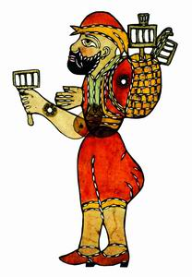
The Boza Man’s Business Plan
What do I need to be a Boza Man?
Leasing of Boza Backpack Vessel
Bulgur Wheat
Spices (vanilla, cinnamon, sugar)
Leasing of Ottoman Costume
Yogurt
Water
Paper cups
Which are my fixed costs?
Which are my variable costs?

Slide 13
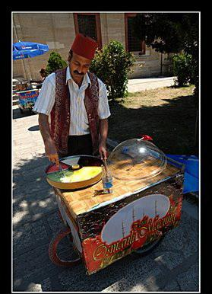

Practice Time! ☺
Lets take a look at ‘Boza Man’ and ‘‘Macuncu’’
Also we could help out the OzU Store

